Slide 1

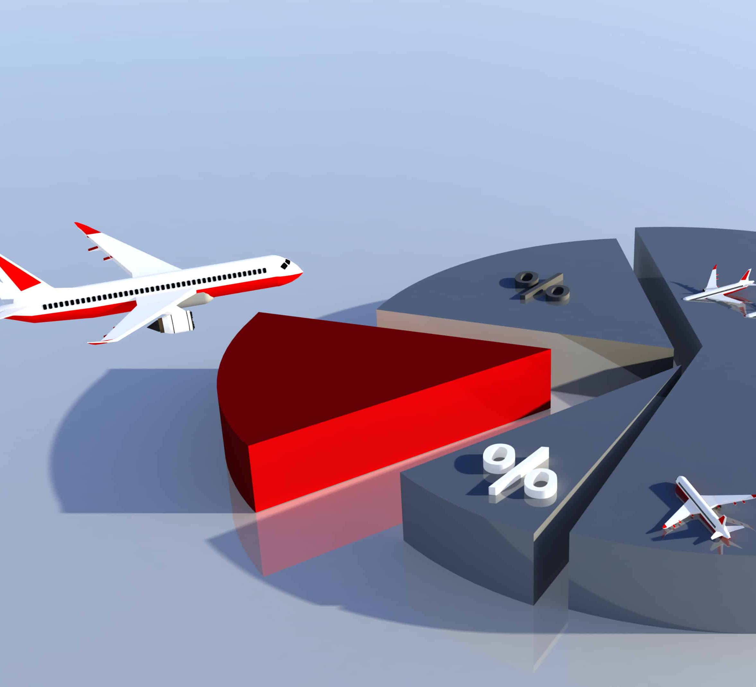

Airtravel safety
Author: Sathish MAnthani

Slide 2
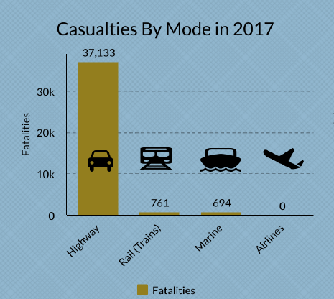
Casualties by transportation type
https://www.cdc.gov/nchs/fastats/accidental-injury.htm

Slide 3
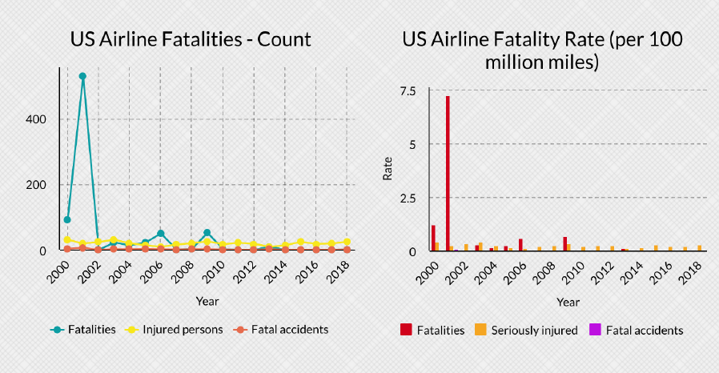
Airline Fatalities

Slide 4
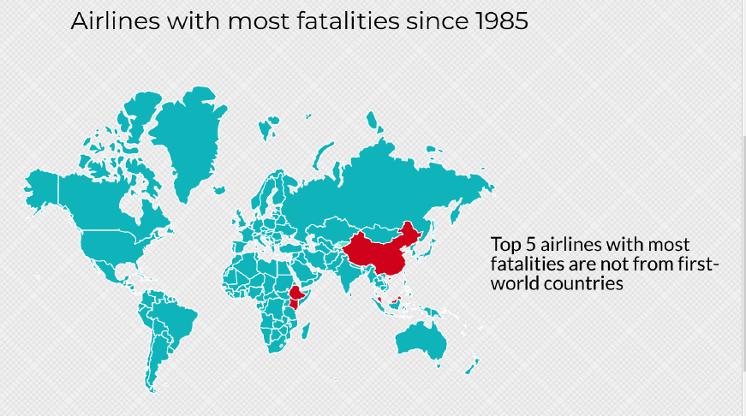
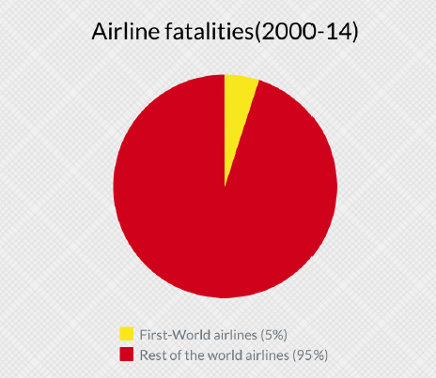
First-world vs other countries

Slide 5
Summary
Airline fatalities are declining with time. Advancement in technology is increasing the safety of air travel.
Americans have a 1 in 114 chance of dying in a car crash and 1 in 9,821 in air travel. [Source: Fortune.com]
Airlines are clearly safer way of traveling than any other transportation mode
In 2000-14 period, only 5% of total fatalities occurred by airline operated by first-world country. 95% of fatalities occurred in rest of the world airlines.
First-world countries have far less air incidents and fatalities than airlines operated by other countries. So, the advancement in technology and increased safety measures are probably keeping the air travel safer in first world countries.

Slide 6
Thank you

